Slide 1
[Title]
MSA 8030 Communicating with Data
October 21, 2024

Slide 2
Team
Headshot
Headshot
Headshot
Headshot
Change picture by right-clicking on the circle placeholder and browsing for your photo. Once the new photo has been inserted, send the photo to the back by choosing Send to Back from the Align palette. [Home tab > Arrange > Align > Send to Back.]
Name
Name
Name
Name

Slide 3
Business Use-case and Data
Explain the business use-case and your data source
(1 minute)

Slide 4
Observation 1
Explain one observation of your data set. Use visuals and tables.
(1 minute)

Slide 5
Observation 2
Explain one observation of your data set. Use visuals and tables.
(1 minute)

Slide 6
Observation 3
Explain one observation of your data set. Use visuals and tables.
(1 minute)

Slide 7
Observation 4
Explain one observation of your data set. Use visuals and tables.
(1 minute)

Slide 8
Auxiliary

Slide 9
Anything you want to keep

Slide 10
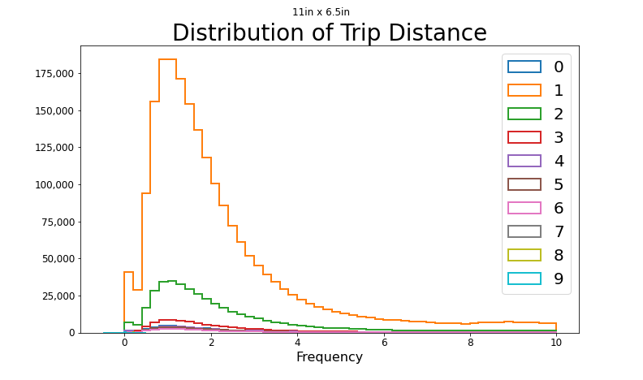
28pt Distribution of Trip Distance
20pt
16pt
12pt
The Matplotlib fonts areb igger
Size of figure
11 x 6.5

Slide 11
field | count | mean | min | 25% | 50% | 75% | max | std
VendorID | 3,066,766 | 1.730 | 1.000 | 1.000 | 2.000 | 2.000 | 2.000 | 0.444
passenger_count | 2,995,023 | 1.363 | 0.000 | 1.000 | 1.000 | 1.000 | 9.000 | 0.896
trip_distance | 3,066,766 | 3.847 | 0.000 | 1.060 | 1.800 | 3.330 | 258928.150 | 249.584
RatecodeID | 2,995,023 | 1.497 | 1.000 | 1.000 | 1.000 | 1.000 | 99.000 | 6.475
PULocationID | 3,066,766 | 166.398 | 1.000 | 132.000 | 162.000 | 234.000 | 265.000 | 64.244
DOLocationID | 3,066,766 | 164.393 | 1.000 | 114.000 | 162.000 | 234.000 | 265.000 | 69.944
payment_type | 3,066,766 | 1.194 | 0.000 | 1.000 | 1.000 | 1.000 | 4.000 | 0.529
fare_amount | 3,066,766 | 18.367 | -900.000 | 8.600 | 12.800 | 20.500 | 1160.100 | 17.808
extra | 3,066,766 | 1.538 | -7.500 | 0.000 | 1.000 | 2.500 | 12.500 | 1.790
mta_tax | 3,066,766 | 0.488 | -0.500 | 0.500 | 0.500 | 0.500 | 53.160 | 0.103
tip_amount | 3,066,766 | 3.368 | -96.220 | 1.000 | 2.720 | 4.200 | 380.800 | 3.827
tolls_amount | 3,066,766 | 0.518 | -65.000 | 0.000 | 0.000 | 0.000 | 196.990 | 2.018
improvement_surcharge | 3,066,766 | 0.982 | -1.000 | 1.000 | 1.000 | 1.000 | 1.000 | 0.183
total_amount | 3,066,766 | 27.020 | -751.000 | 15.400 | 20.160 | 28.700 | 1169.400 | 22.164
congestion_surcharge | 2,995,023 | 2.274 | -2.500 | 2.500 | 2.500 | 2.500 | 2.500 | 0.772
airport_fee | 2,995,023 | 0.107 | -1.250 | 0.000 | 0.000 | 0.000 | 1.250 | 0.356
This is way too much!

Slide 12
Color palette
Primary Palette
Text and Background Colors - RGB values
Accent Colors – RGB values
241-242-242 Paper White
64-64-65 Black
164-169-173 Gritty Gray
0-57-166 GSU Blue
239-118-34 Cool Blue
196-12-48 GSU Red
0-111-66 Pioneer Green
0-175-240 Vibrant Blue
151-202-235 Light Blue
235-235-234 Light Gray
Recent Colors Palette
Additional colors. This additional palette rotates recently used colors. Colors can also be deleted if new colors are created.
119-5-32 Dark Red
0-31-91 Legacy Navy

